Slide 1
Environmental Studies Unit 1: Introduction
By: Mr. Dhruv Trivedi

Slide 2


Slide 3
The Multidisciplinary Nature of Environmental Studies
1. Biology
Focus: Study of living organisms and their interactions with the environment.
Relevance: Understanding ecosystems, biodiversity, and the impacts of pollutants on flora and fauna.
2. Chemistry
Focus: Chemical processes and substances in the environment.
Relevance: Analyzing pollutants, chemical cycles, and the chemical basis of environmental health.
3. Physics
Focus: Physical principles governing natural processes.
Relevance: Studying energy transfer, climate systems, and the physical impact of environmental changes.
4. Geology
Focus: Earth's structure, materials, and processes.
Relevance: Understanding soil composition, natural resource distribution, and geological hazards.

Slide 4
5. Geography
Focus: Spatial aspects of natural and human phenomena.
Relevance: Mapping environmental changes, studying land use patterns, and assessing the impact of human activities on different regions.
6. Ecology
Focus: Interactions between organisms and their environment.
Relevance: Understanding ecosystem dynamics, species interactions, and the effects of environmental changes on living systems.
7. Social Sciences
Focus: Human behavior, policies, and economics related to the environment.
Relevance: Studying the social dimensions of environmental issues, such as public policy, environmental justice, and economic impacts.
8. Environmental Policy and Management
Focus: Development and implementation of policies and strategies to manage environmental resources.
Relevance: Crafting regulations and practices for sustainable resource use and pollution control.
9. Environmental Engineering
Focus: Application of engineering principles to improve and maintain environmental quality.
Relevance: Designing technologies for waste treatment, pollution control, and sustainable infrastructure.

Slide 5
Environmental Science : Definition
Environmental Science is an interdisciplinary field that encompasses various scientific disciplines to study the environment and address environmental issues. It aims to understand the interactions between the physical, chemical, and biological components of the environment.

Slide 6
Environmental Science : Scope
Interdisciplinary Integration: Combines natural sciences (biology, chemistry, physics), social sciences (economics, sociology, political science), and humanities (ethics, philosophy) to provide a holistic understanding of environmental issues.
Natural Resource Management: Focuses on the sustainable use and management of natural resources such as water, soil, minerals, forests, and wildlife to ensure their availability for future generations.
Environmental Conservation: Involves the protection and preservation of ecosystems and biodiversity, addressing issues like habitat destruction, endangered species, and conservation strategies.
Pollution Control and Waste Management: Studies the sources, effects, and control measures of pollutants in air, water, and soil, along with waste management practices such as recycling, composting, and waste reduction.

Slide 7
Environmental Policy and Law: Examines environmental laws, regulations, and policies at local, national, and international levels, including their development, implementation, and enforcement.
Sustainable Development: Promotes development that meets current needs without compromising the ability of future generations to meet their own needs, integrating economic, social, and environmental dimensions.
Climate Change and Global Warming: Investigates the causes and impacts of climate change, global warming, and strategies for mitigation and adaptation.
Human-Environment Interaction: Studies the ways humans interact with their environment, including the social, cultural, and economic factors that influence environmental decision-making.
Environmental Health: Focuses on how environmental factors affect human health, addressing issues such as air and water quality, toxic substances, and occupational health.
Education and Awareness: Promotes environmental education and awareness to foster a culture of sustainability and responsible environmental stewardship among individuals and communities.

Slide 8
Environmental Science : Importance
Environmental Awareness: Raises awareness about the impact of human activities on the environment, encouraging individuals and communities to adopt sustainable practices.
Sustainable Resource Management: Helps in understanding and implementing practices that ensure the sustainable use of natural resources, preventing depletion and degradation.
Policy Development: Informs policymakers and helps in the development of effective environmental policies and regulations that protect natural resources and public health.
Biodiversity Conservation: Emphasizes the importance of preserving biodiversity, which is crucial for ecosystem stability, resilience, and the provision of ecosystem services.
Climate Change Mitigation and Adaptation: Provides knowledge and tools to mitigate the effects of climate change and develop adaptive strategies to cope with its impacts.

Slide 9
Public Health Protection: Addresses environmental health issues, promoting actions that reduce pollution and exposure to hazardous substances, thereby protecting public health.
Economic Benefits: Highlights the economic benefits of sustainable practices, such as reduced costs from waste management, energy efficiency, and conservation initiatives.
Cultural and Ethical Considerations: Encourages the consideration of cultural values and ethical principles in environmental decision-making, fostering a sense of responsibility towards nature.
Disaster Management: Enhances understanding of natural disasters and strategies for risk reduction, preparedness, and response to minimize the impact on communities and the environment.
Research and Innovation: Promotes scientific research and technological innovation to develop new solutions for environmental challenges, driving progress towards sustainability.

Slide 10
Evolution of the Universe

Slide 11

1. The Big Bang Theory
Origin: The universe began approximately 13.8 billion years ago with an event known as the Big Bang.
Description: The Big Bang was a massive expansion that marked the beginning of the universe, where all matter and energy were concentrated in an extremely hot and dense state.

Slide 12
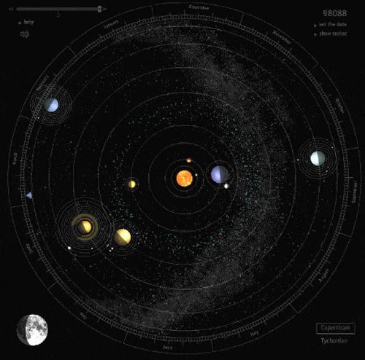
2. Formation of Basic Elements
Primordial Nucleosynthesis: Within the first few minutes of the Big Bang, temperatures were high enough to fuse protons and neutrons, forming the first atomic nuclei.
Elements: The process primarily formed hydrogen, helium, and trace amounts of lithium.

Slide 13

3. The "Dark Ages"
Definition: A period after the Big Bang when the universe had cooled enough for electrons to combine with protons and form neutral hydrogen atoms, but before the formation of stars and galaxies.
Cosmic Background Radiation: This period ended when the first stars and galaxies formed, emitting light and reionizing the hydrogen in the universe.

Slide 14

4. Formation of Stars and Galaxies
Gravitational Collapse: Regions of slightly higher density in the early universe began to collapse under their own gravity, forming the first stars and galaxies.
Star Formation: Stars formed from clouds of gas and dust, undergoing nuclear fusion to produce heavier elements.
Galaxy Formation: Galaxies formed as gravitationally bound systems of stars, gas, dust, and dark matter. They evolved through mergers and interactions.

Slide 15

5. Stellar Evolution and Element Formation
Life Cycle of Stars:
Main Sequence: Stars spend most of their lives fusing hydrogen into helium.
Red Giant/Supergiant: After exhausting hydrogen, stars expand and fuse heavier elements.
Supernova: Massive stars explode in supernovae, dispersing heavy elements into space.
Nucleosynthesis: Formation of elements heavier than iron occurs in supernovae, contributing to the cosmic abundance of elements.

Slide 16
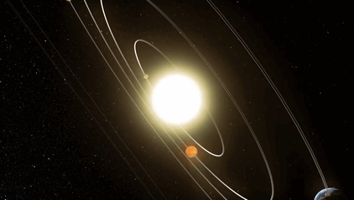
6. Formation of Solar System
Solar Nebula Theory: Our solar system formed about 4.6 billion years ago from a rotating cloud of gas and dust (solar nebula).
Planetary Formation: Through accretion, particles in the solar nebula clumped together to form planetesimals, which eventually formed planets.
Earth's Formation: The Earth formed through the accretion of planetesimals and underwent differentiation, leading to the formation of its core, mantle, and crust.

Slide 17

7. Evolution of the Universe
Cosmic Expansion: The universe continues to expand, with galaxies moving away from each other.
Dark Matter and Dark Energy:
Dark Matter: Makes up about 27% of the universe's mass-energy content, influencing the formation and behavior of galaxies.
Dark Energy: Accounts for about 68% of the universe's mass-energy content and is responsible for the accelerated expansion of the universe.

Slide 18

8. Future of the Universe
Big Freeze: If the expansion continues indefinitely, the universe may end in a "Big Freeze," where stars burn out, galaxies drift apart, and the universe becomes dark and cold.
Big Crunch: An alternative theory suggests that if the expansion slows and reverses, the universe may collapse back into a hot, dense state.
Big Rip: Another possibility is that the expansion accelerates so much that it tears apart galaxies, stars, and even atomic particles.

Slide 19

Origin of the Earth

Slide 20
Origin of the Earth
1. Formation of the Solar System
2. Accretion of Planetary Bodies
3. Formation of Earth
4. Formation of the Moon
5. Early Atmosphere and Oceans
6. Development of the Crust

Slide 21
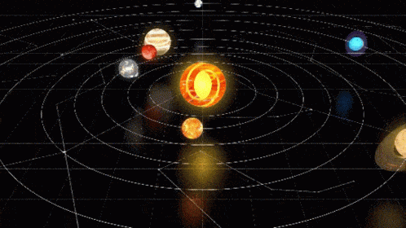
Solar System

Slide 22
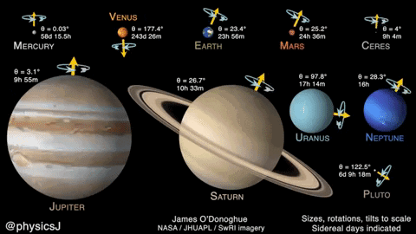
Solar System
1. The Sun
2. Planets
Terrestrial Planets
Mercury
Venus
Earth
Mars
Gas Giants
Jupiter
Saturn
Uranus
Neptune
3. Dwarf Planets
4. Moons
5. Asteroids and Comets
6. Influence on Earth

Slide 23
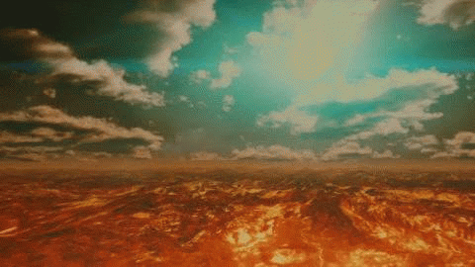
Atmosphere of the Primitive Earth

Slide 24
Atmosphere of the Primitive Earth
1. Composition of the Primitive Atmosphere
Primary Gases: The primitive atmosphere was likely composed of gases released during the formation of Earth and subsequent volcanic activity. These included:
Hydrogen (H2) and Helium (He): Initially present due to their abundance in the solar nebula.
Water Vapor (H2O): Released from the Earth's interior through volcanic outgassing.
Carbon Dioxide (CO2) and Carbon Monoxide (CO): Released from volcanic activity and possibly present in the solar nebula.
Nitrogen (N2): Also released from volcanic outgassing.
Methane (CH4) and Ammonia (NH3): Present in smaller quantities, depending on conditions.
Lack of Free Oxygen: Unlike the current atmosphere, the primitive atmosphere was largely devoid of free oxygen (O2). Oxygen likely existed in the form of oxides (e.g., carbon dioxide) due to the reducing conditions prevalent at the time.
2. Evolution of the Primitive Atmosphere
Early Volcanism: Volcanic outgassing from the Earth's interior played a significant role in shaping the composition of the primitive atmosphere. This process released gases trapped within the Earth's mantle and crust, contributing to the atmospheric composition.
Impact Events: During the early stages of Earth's formation, frequent impact events from asteroids and comets could have influenced the atmosphere by releasing additional gases and water vapor into the atmosphere.

Slide 25
3. Role in Early Earth Conditions
Greenhouse Effect: The primitive atmosphere, rich in carbon dioxide and methane, likely created a strong greenhouse effect, trapping heat and warming the Earth's surface. This greenhouse effect was crucial for maintaining liquid water on the surface despite the lower solar luminosity of the young Sun.
Chemical Reactions: The early atmosphere supported chemical reactions that were essential for the formation of organic molecules, including amino acids and nucleotides, which are the building blocks of life.
4. Transition to the Modern Atmosphere
Great Oxygenation Event: Around 2.4 billion years ago, cyanobacteria began to perform photosynthesis, releasing oxygen as a byproduct. This led to the gradual accumulation of oxygen in the atmosphere, marking the beginning of the Great Oxygenation Event.
Formation of Ozone Layer: The accumulation of oxygen eventually led to the formation of an ozone (O3) layer in the upper atmosphere, providing protection against harmful ultraviolet (UV) radiation from the Sun.
5. Implications for Environmental Studies
Studying the atmosphere of the primitive Earth provides insights into:
The conditions that supported the origins and early evolution of life.
The role of atmospheric composition in climate regulation and surface conditions.
Understanding past climate dynamics and the factors that shaped Earth's environmental history.

